Slide 1


Puzzles For Placements
IET FEB-2020 BATCH

Slide 2
#1 Puzzle
A birthday cake
A birthday cake has to be equally divided into 8 equal pieces in exactly 3 cuts.
Determine the way to make this division possible.

Slide 3
Solution of Puzzle
The approach entails slicing the cake horizontally down the center.
followed by making another division vertically through the center.
The two divisions made across horizontal and vertical directions will give you 4 equal pieces of the cake.
In the final step, simply stack the 4 pieces one above the other, and then make the third division, splitting the stack into half. This gives you the 8 equal pieces of cake, along with answer to your puzzle.

Slide 4
#2 Puzzle
Bag of Coins
You have 10 bags full of coins, In each bag are infinite coins.
one bag is full of forgeries, and you can’t remember which one. But you do know that a genuine coins weigh 10 gram, but forgeries weigh 9 grams.
You have to identify that bag in single reading. You are provided with a digital weighing machine.

Slide 5
Solution of Puzzle
Take 1 coin from the first bag, 2 coins from the second bag, 3 coins from the third bag and so on.
Eventually, we’ll get 55 (1+2+3…+9+10) coins.
Weigh all the 55 coins together.
Depending on the resulting weighing machine reading, you can find which bag has the forged coins, if it weighs 1 gram less then it will would be 1st Bag.
If it 2 gram less then it would be 2nd Bag & So On.

Slide 6
#3 Puzzle
Prisoners and hats
There are 100 prisoners all sentenced to death. One night before the execution, the warden gives them a chance to live if they all work on a strategy together. The execution scenario is as follows –
On the day of execution, all the prisoners will be made to stand in a straight line such that one prisoner stands just behind another and so on.
All prisoners will be wearing a hat either of BLACK or WHITE. The prisoners don’t know what colour of hat they are wearing.
The prisoner who is standing at the last can see all the prisoners in front of him (and what colour of hat they are wearing).
A prisoner can see all the hats in front of him. The prisoner who is standing in the front of the line cannot see anything.
The executioner will ask each prisoner what colour of hat they are wearing one by one, starting from the last in the line. The prisoner can only speak BLACK or WHITE. He cannot say anything else. If he gets it right, he lives otherwise he is shot instantly. All the prisoners standing in front of him can hear the answers and gunshots.
Assuming that the prisoners are intelligent and would stick to the plan, what strategy would the prisoners make over the night to minimize the number of deaths?

Slide 7
Solution of Puzzle
The strategy is that the last person will say ‘white’ if the number of white hats in front of him are odd and else Blue.
The trick of this Puzzle is to remember the first Prisoner call.

Slide 8
#4 Puzzle
Rat and Poisonous Milk Bottles
You have 4 bottles of milk. One of them is poisonous while the other 3 are non-poisonous.
There is a rat which dies exactly after 10 hours of drinking the poisoned bottle.
You have a clock that measures time only in hours.
Suggest an optimal strategy to identify the poisoned bottle within 24 hours.

Slide 9
Solution of Puzzle
At the beginning of the first hour feed the rat the Ist bottle. At the start of 2nd-hour feed, the 2nd one and
similarly at the start of 3rd-hour feed, the 3rd bottle.
If the rat dies after exactly 10 hrs, the first bottle
is poisonous.
If it dies after 11 hours, 2nd one contains poison else the 3rd one is poisonous.
In this way, after exactly 12 hours you would be able to determine the poisonous bottle.

Slide 10
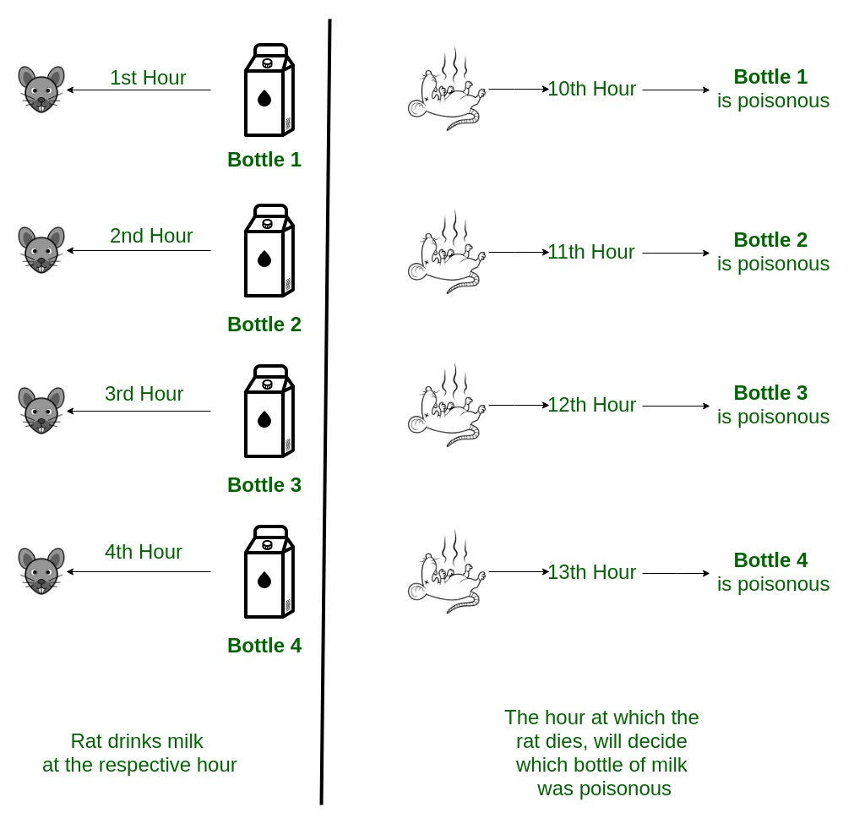
Image solution

Slide 11
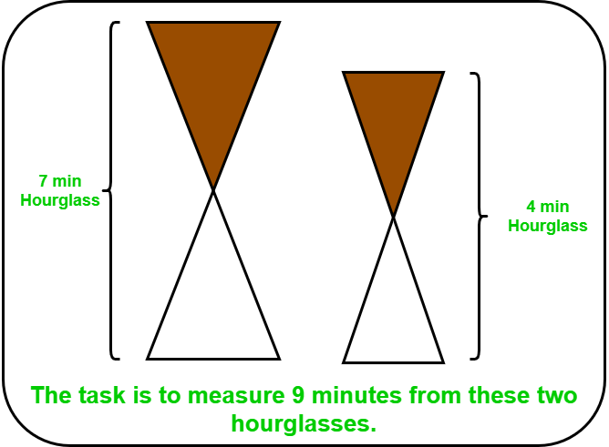
#Puzzle 5
Hourglasses Puzzle
1) Given two hourglass of 4 minutes and 7 minutes, the task is to measure 9 minutes.

Slide 12
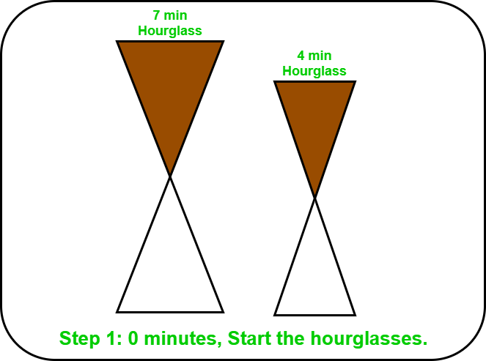
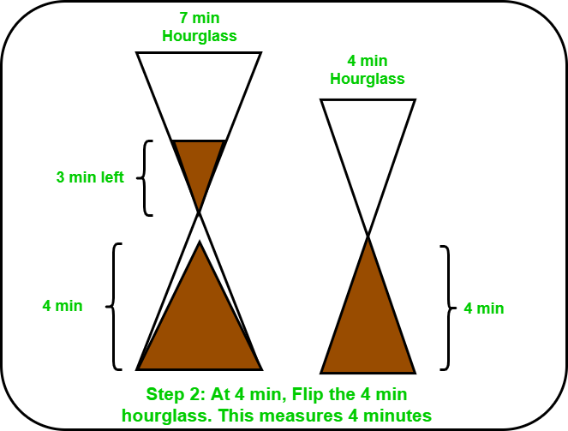
Solution of Puzzle
Step-1 At 0 minutes: Start both hourglasses at the same time. Step -2 At 4 minutes: 4 minutes hourglass runs out at
7 minutes hourglass is left with 3 minutes it.

Slide 13
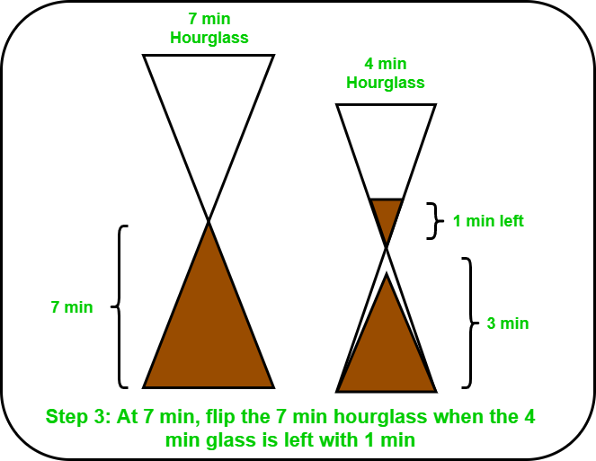
Solution Continue..
Step 3 - At 7 minutes: 4 minutes hourglass is left with 1 minute.
7 minutes hourglass runs out and flip it. Step 4 - At 8 minutes: 4 minutes hourglass runs out and 7 is filled with 6 minutes and 1 minute on the other side. Flip it as the sand is left with 1 minute.

Slide 14
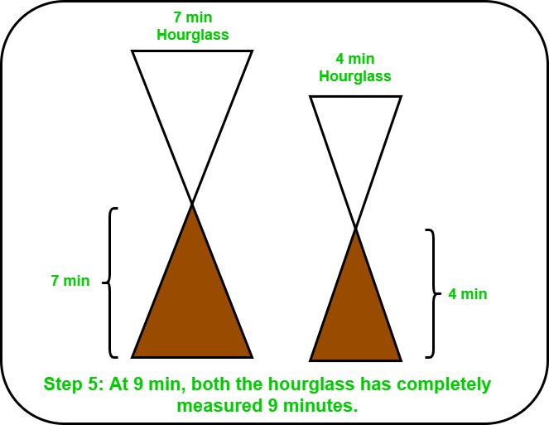
Solution Continue..
Step 4 - At 9 minutes: 7 minutes hourglass becomes empty from above side.

Slide 15
#puzzle 6
Bridge crossing in 17 Minutes with Torch
(Google, Microsoft, Nvidia, Bloomberg, Morgan Stanley)
Adam, Bob, Clair and Dave are out walking: They come to rickety old wooden bridge. The bridge is weak and only able to carry the weight of two of them at a time. Because they are in a rush and the light is fading they must cross in the minimum time possible and must carry a torch (flashlight,) on each crossing.
They only have one torch and it can't be thrown. Because of their different fitness levels and some minor injuries they can all cross at different speeds. Adam can cross in 1 minute, Bob in 2 minutes, Clair in 5 minutes and Dave in 10 minutes.
Adam, the brains of the group thinks for a moment and declares that the crossing can be completed in 17 minutes. There is no trick. How is this done?

Slide 16
Solution of Puzzle
Initially most people would tend to assume the the quickest way is to have Adam (1) carry the torch and do all the running. This however, is not the case, the quickest time is achieved by having Clair(5) and Dave(10) cross together.
For simplicity Adam, Bob, Clair and Dave will be know as (1), (2), (5) & (10) respectively
Move | Time
(1) & (2) Cross with Torch | 2
(1) Returns with Torch | 1
(5) & (10) Cross with Torch | 10
(2) Returns with Torch | 2
(1) & (2) Cross with Torch | 2
 | 17

Slide 17
#Puzzle 7
The Wolf, Goat, and Cabbage
A man has to take a wolf, a goat, and some cabbage across a river. His rowboat has enough room for the man plus either the wolf or the goat or the cabbage.
If he takes the cabbage with him, the wolf will eat the goat. If he takes the wolf, the goat will eat the cabbage.
Only when the man is present are the goat and the cabbage safe from their enemies. All the same, the man carries wolf, goat, and cabbage across the river. How?

Slide 18
Solution of Puzzle
The wolf does not eat cabbage, so the crossing can start with the goat.
The man leaves the goat and returns, puts the cabbage in the boat and takes it across. On the other bank, he leaves the cabbage but takes the goat.
He leaves the goat on the first bank and takes the wolf across. He leaves the cabbage with the wolf and rows back alone.
He takes the goat across.

Slide 19
#Puzzle 8
Monkeys and Doors
Two trains are on same track and they are coming toward each other.
The speed of the first train is 50 km/h and the speed of the second train is 70 km/h.
A bee starts flying between the trains when the distance between two trains is 100 km.
The bee first flies from first train to second train. Once it reaches the second train, it immediately flies back to the first train … and so on until trains collide.
Calculate the total distance travelled by the bee. Speed of bee is 80 km/h.

Slide 20
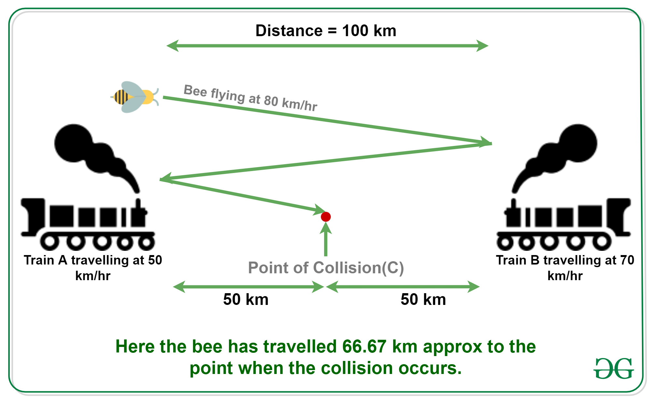
Solution of Puzzle
Let the first train A move at u km/h.
Let the second train B move at v km/h.
Let the distance between two trains be d km
Let the speed of bee be b km/h
Therefore, the time taken by trains to collide = d/(u+v)
Now putting all the known values into the above equation, we get,
u = 50 km/hr. v = 70 km/hr. d = 100 km b = 80 km/hr.
Therefore, the total distance travelled by bee = b*d/(u+v) = 80 * 100/(50+70) = 66.67 km (approx)
Please write comments if you find anything incorrect, or you want to share more information about the topic discussed above

Slide 21
#Puzzle 9
3 Bulbs and 3 Switches
There is a room with a door (closed) and three light bulbs. Outside the room there are three switches, connected to the bulbs.
You may manipulate the switches as you wish, but once you open the door you can’t change them.
Identify each switch with its bulb.

Slide 22
Solution of Puzzle
Let the bulbs be X, Y and Z
Turn on switch X for 5 to 10 minutes. Turn it off and turn on switch Y. Open the door and touch the light bulb.
1. if the light is on, it is Y
2. if the light is off and hot, it is X
3. if the light is off and cold, it is Z

Slide 23
#Puzzle 10
Maximum run in cricket
In a one day international cricket match, considering no extras(no wides, no ‘no’ balls, etc.) and no overthrows.
What is the maximum number of runs that a batsman can score in an ideal case ?
Hint - Note:”Here we assume ideal and little practical scenario. We assume that batsman can not run for more than 3 runs in a ball, as otherwise there is no limit, he can run infinite runs(theoretically) in a ball, as far as opposite team does not catch the ball.”

Slide 24
Solution of Puzzle
Explanation
49*(6*5+3)+(6*6)= 1653
From Over 1 to 49:
1st ball:- 6 runs(hit six)
2nd ball:- 6 runs(hit six)
3rd ball:- 6 runs(hit six)
4th ball:- 6 runs(hit six)
5th ball:- 6 runs(hit six)
6th ball:- 3 runs(took 3 runs between the wickets and take back the strike)
>49*(6*5+3)
50th Over:
Hit six sixes in a row.
= >6*6

Slide 25
#puzzle 11
Rs 500 Note Puzzle
A Lady (L) bought an item of Rs 100 from the Shopkeeper (C).
She paid him through a 500 Rs Note.
Realizing that he did not have change, the shopkeeper C got change for that note from another shopkeeper (S) and paid Rs 400 to the Lady.
After a few days, S realized that the note is fake, And this railed at C and took 500 Rs back from him.
So in this whole process how much money did C loose in the end?

Slide 26
Solution of Puzzle
Answer: 500
Explanation:
The total loss for shopkeeper = 500 ( given back to the person who had provided the change )
Consider a transaction box, the lady came with a counterfeit 500 Rs note which can be considered of 0 value.
Now the lady took the item (cost of the item 100 Rs ) and 400 Rs (the change given by shopkeeper(C) to the lady)
from the transaction box, total of 500 Rs.
Now the equivalent amount should be lost by someone, thus shopkeeper(C) lost 500 Rs. Another shopkeeper(S) gave 500 Rs and took back the same amount hence no loss for him.

